Slide 1

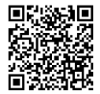
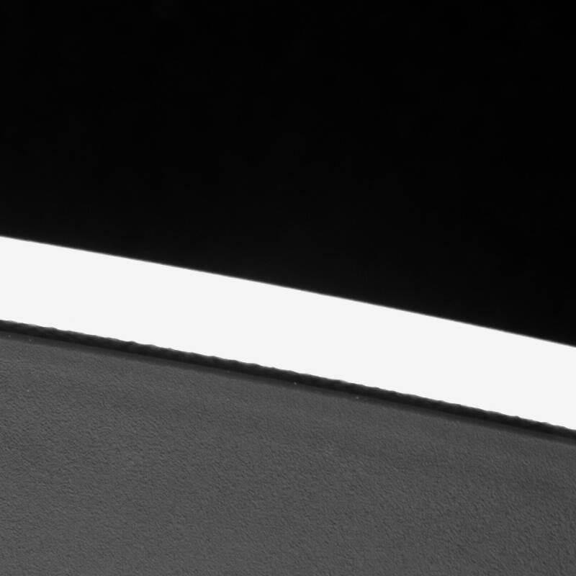
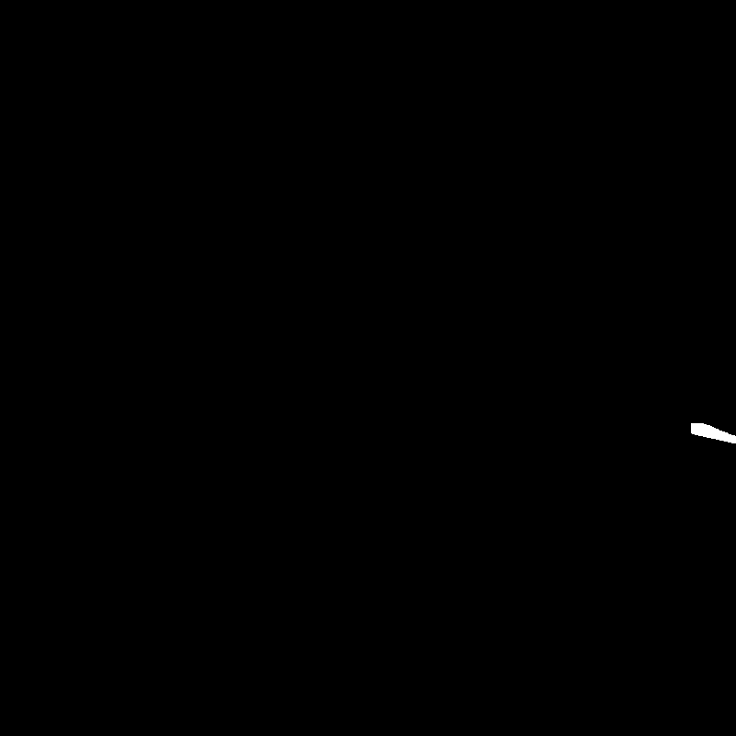
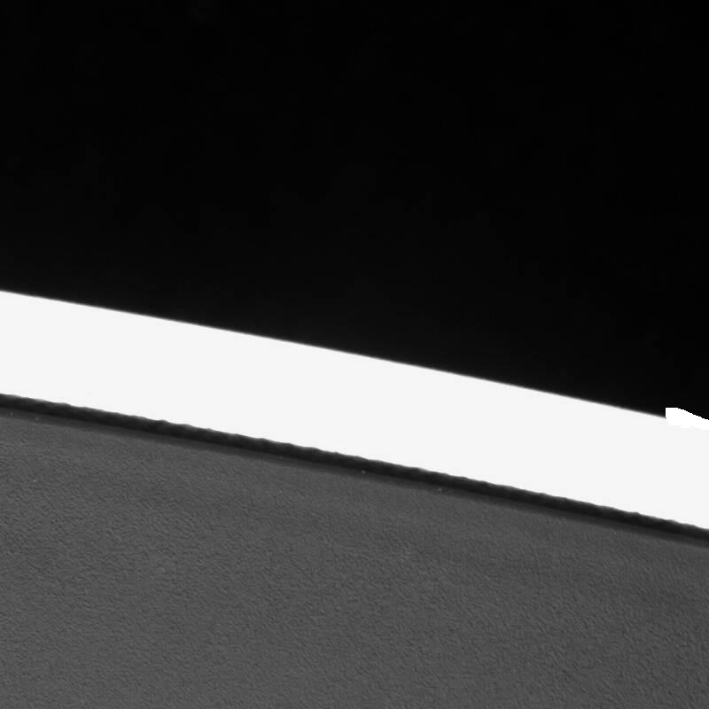
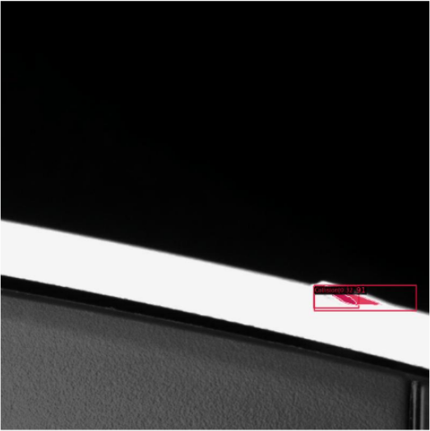
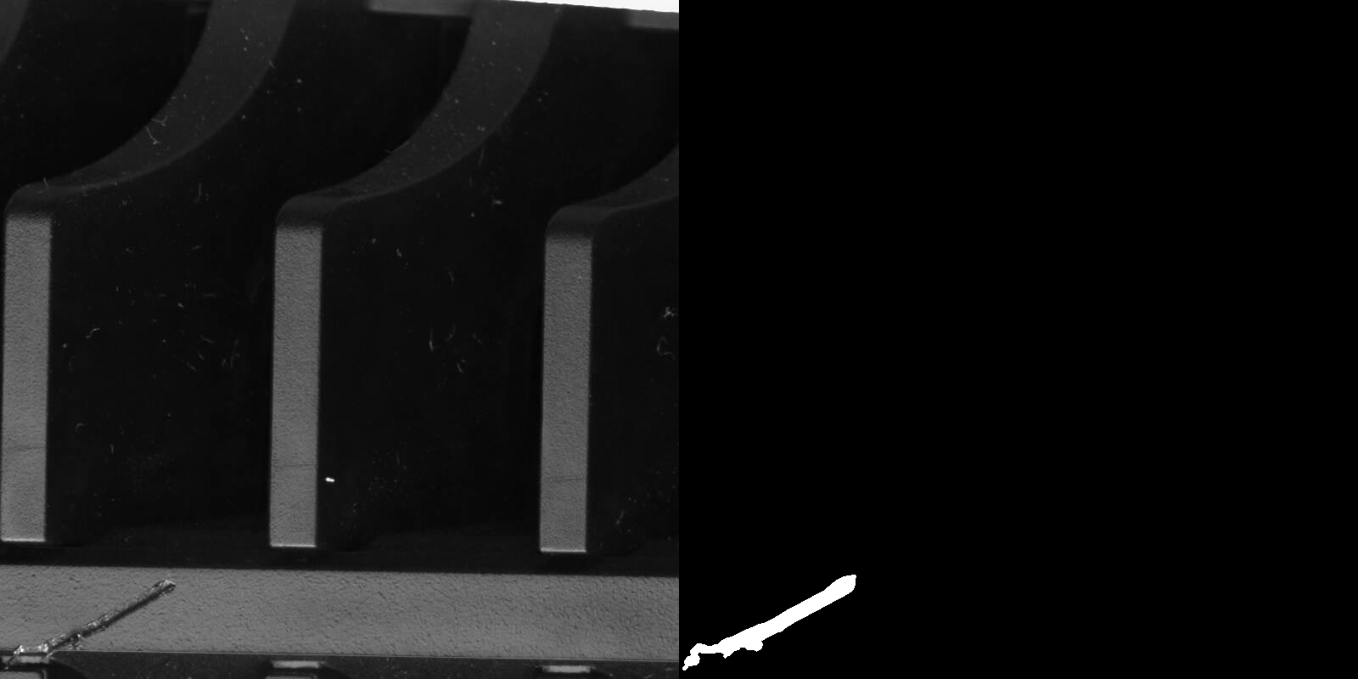
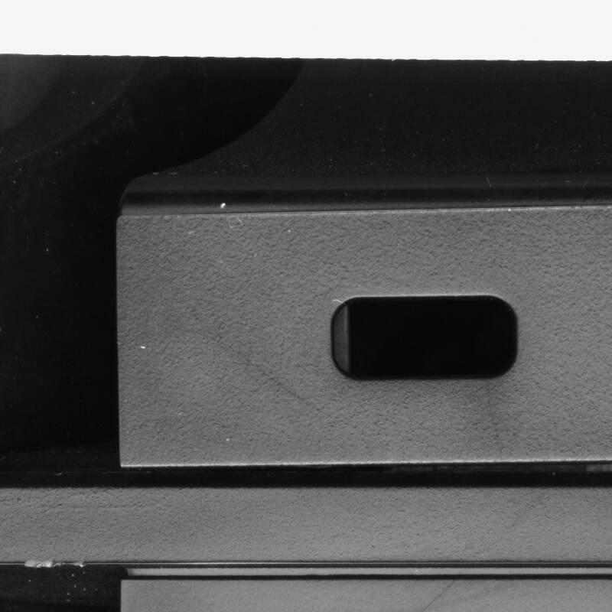
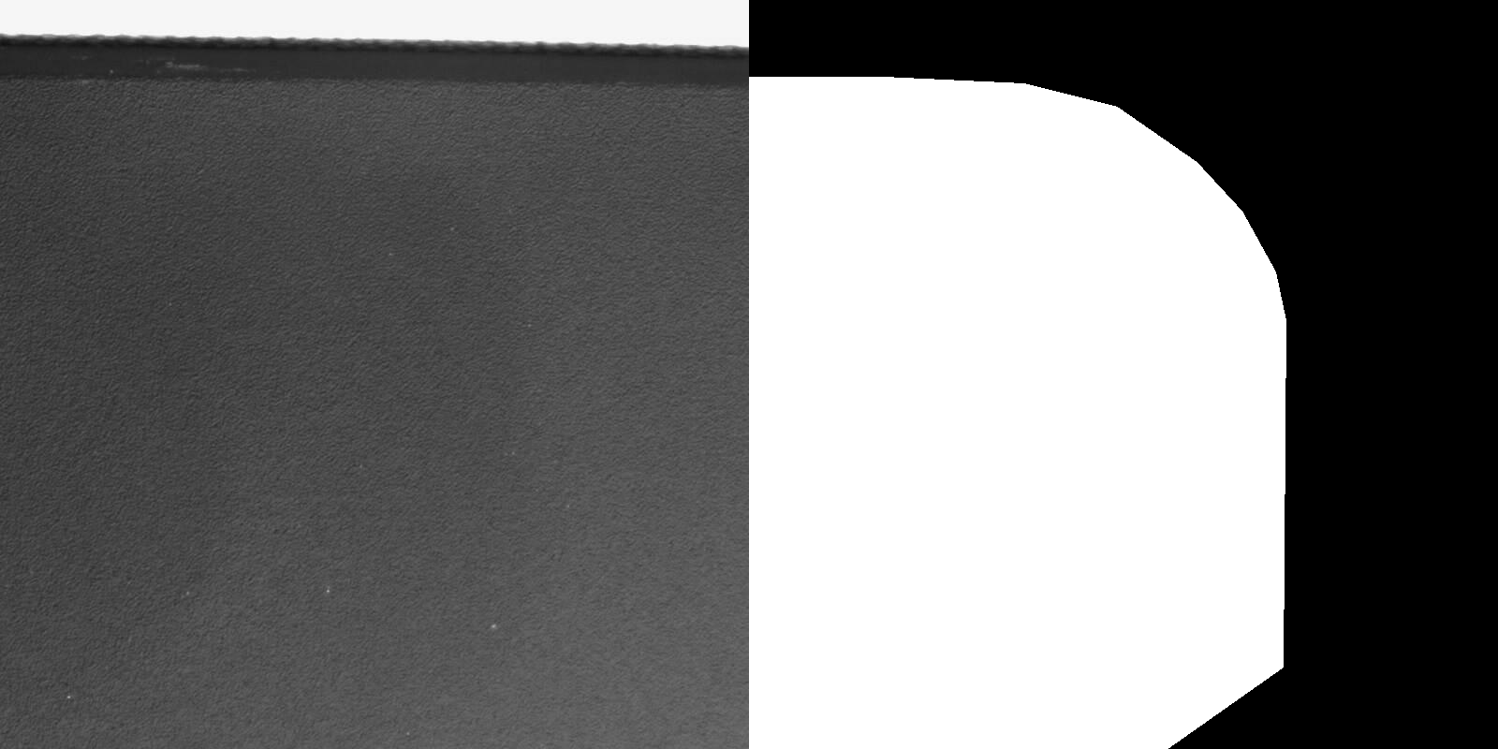
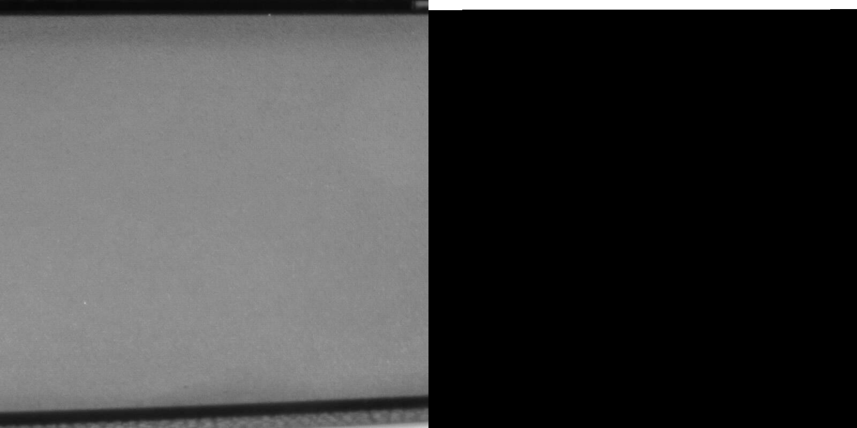
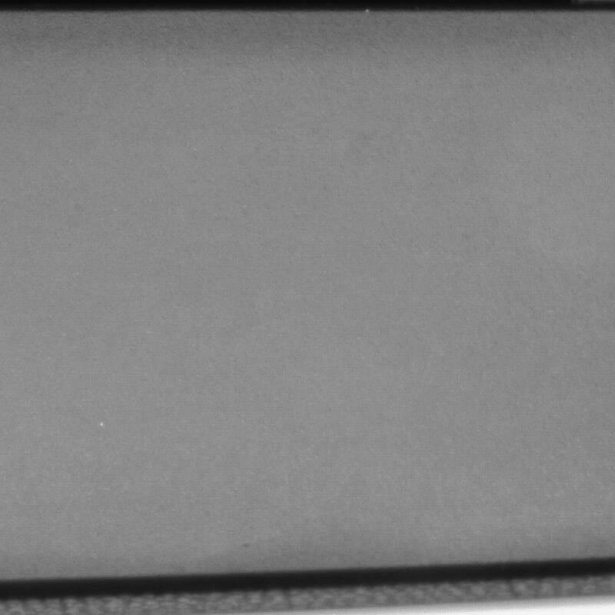
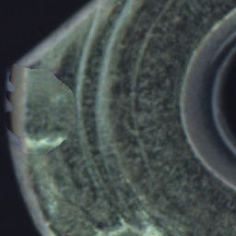
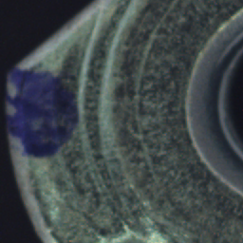

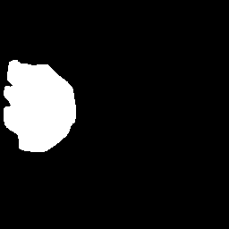
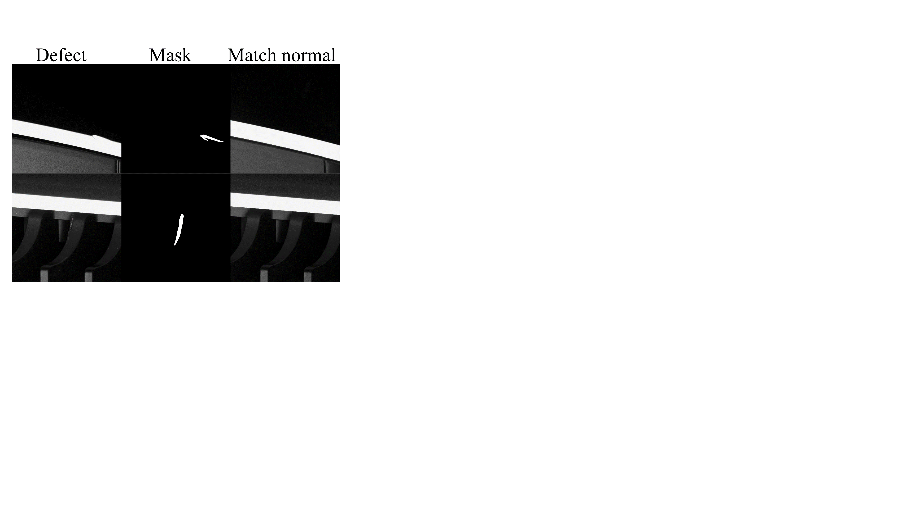
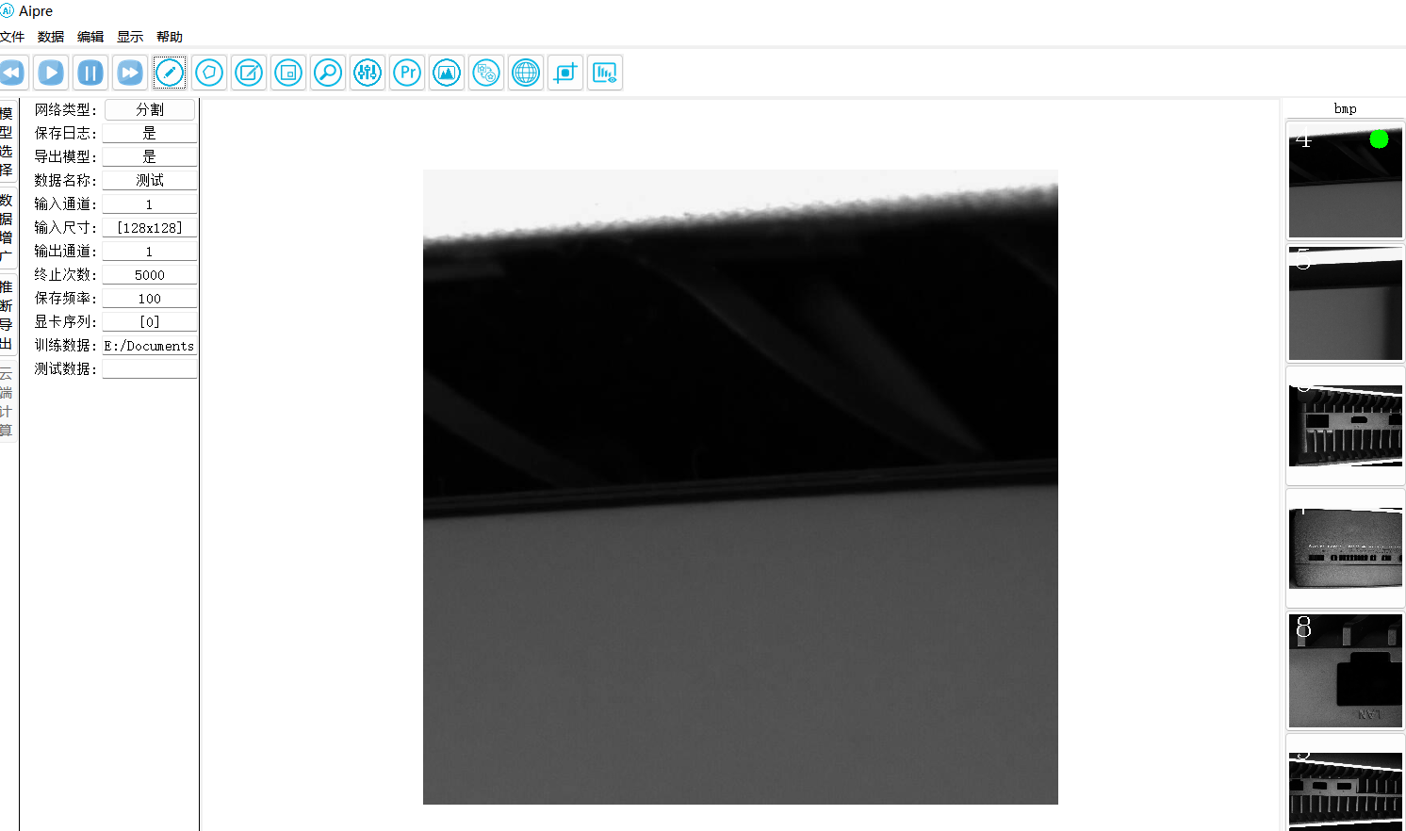
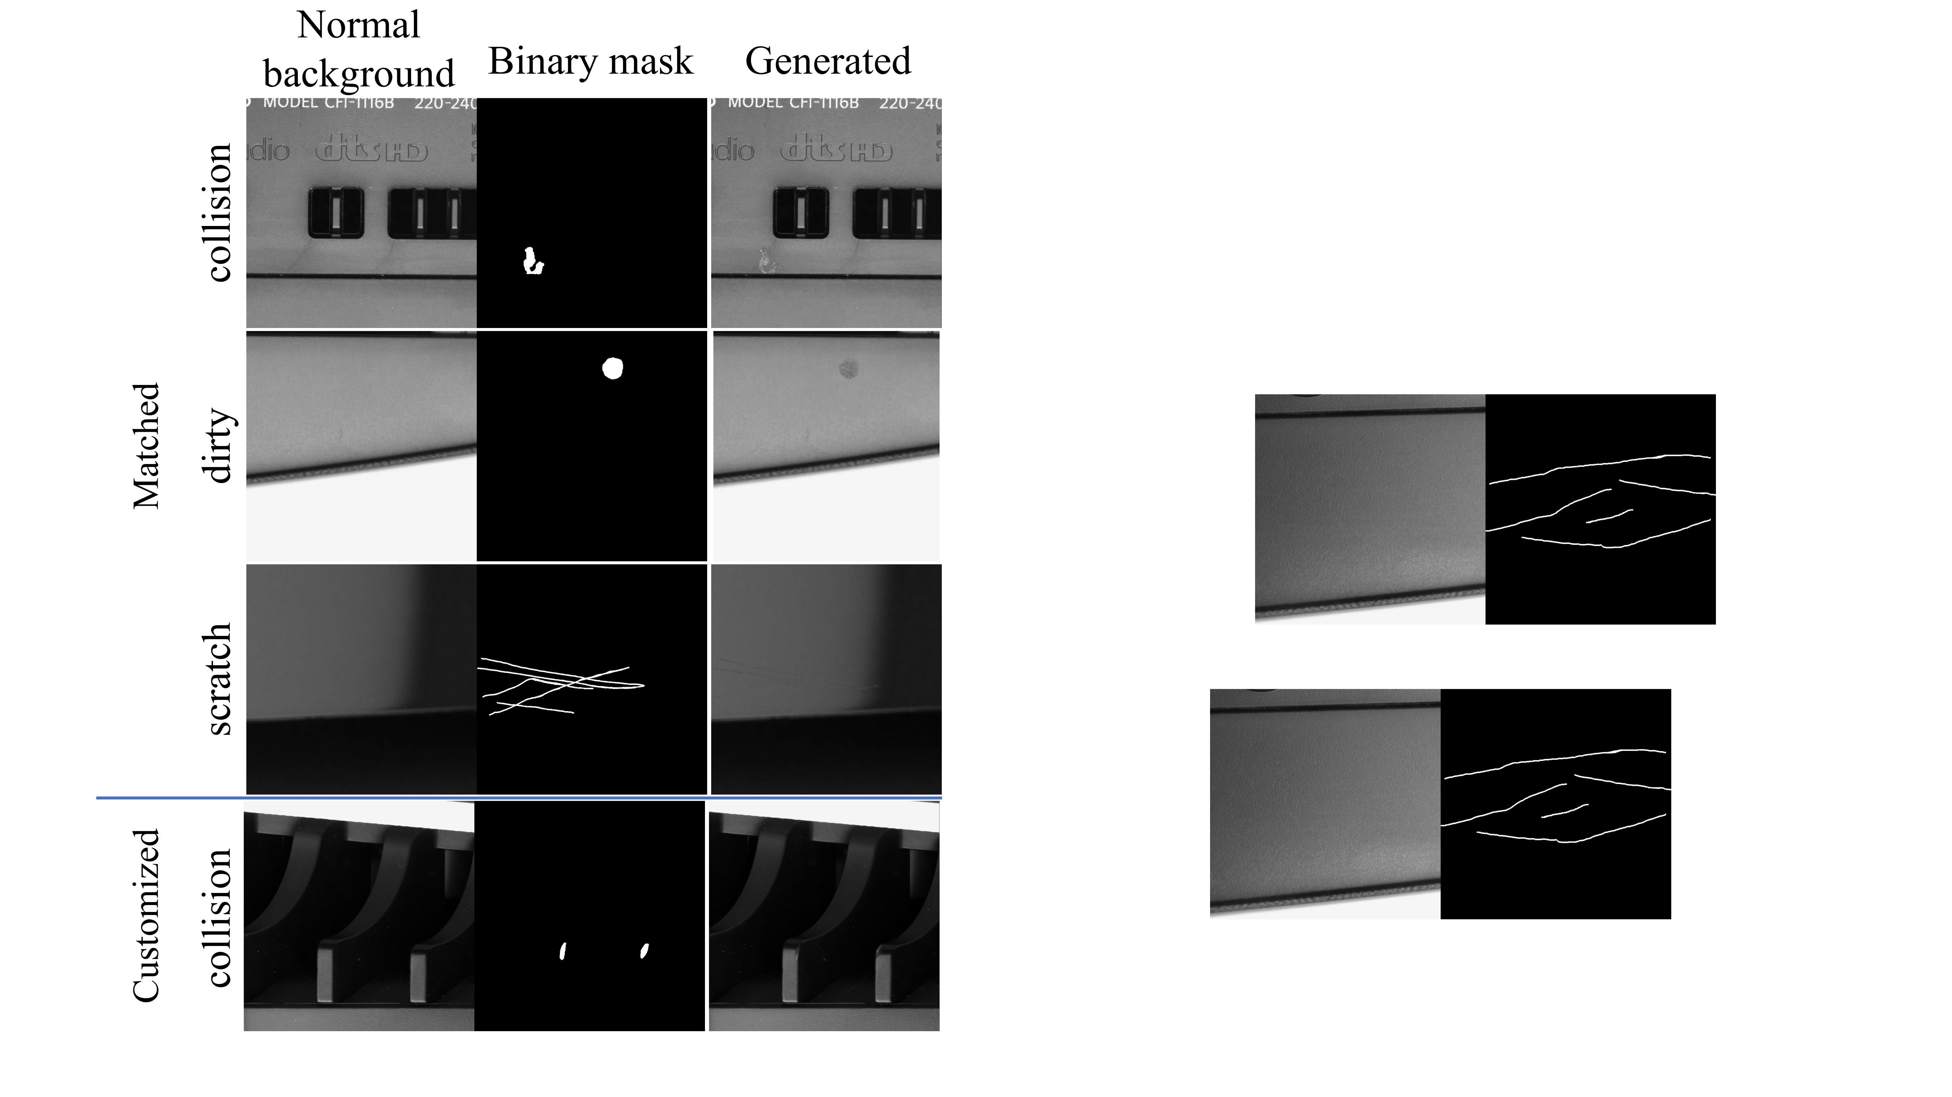
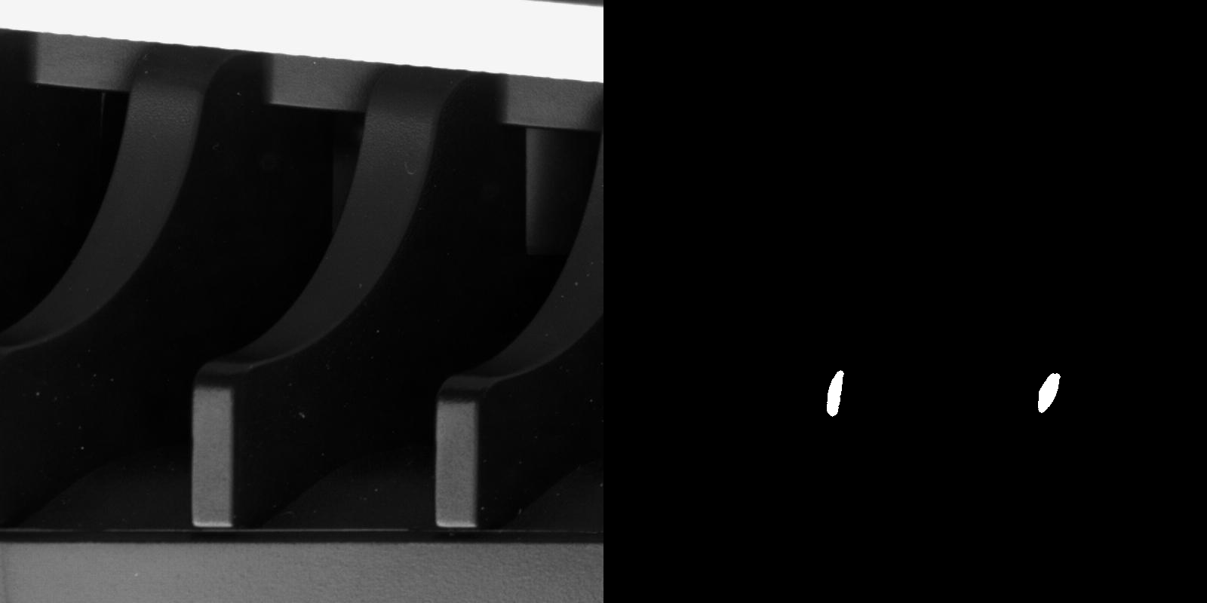

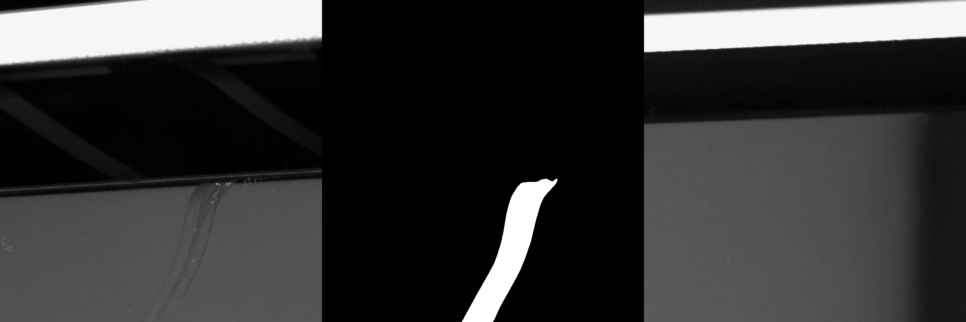
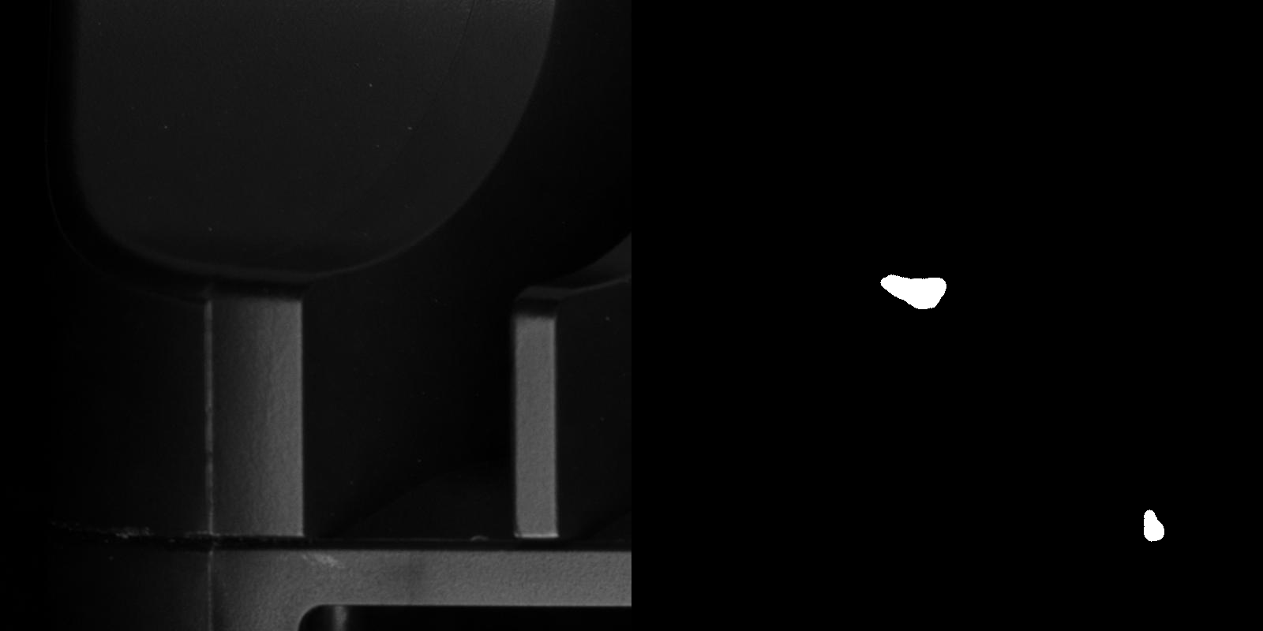

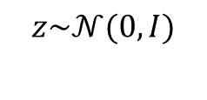
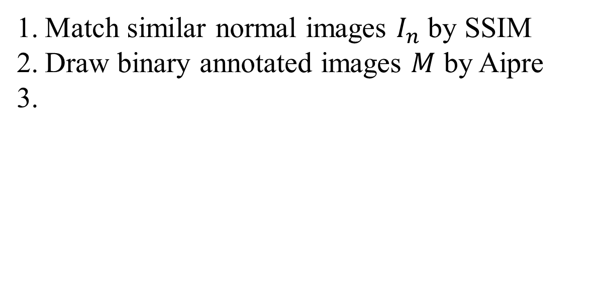
Most Innovative Solution in VISION Track 2 Challenge
Jing Wei^{1,2} Zhi Li¹ Qingfeng Shi¹ Xian Tao^{1,2} Chengkan Lv ^{1,2}
¹Institute of Automation, Chinese Academy of Sciences, ²CASI Vision Technology CO.
Key point:
Exploring the potential of high-quality samples and finding “golden samples” suitable for the detection model is more favorable than simply increasing non-redundant samples.
Main methods:
1) Choosing the most suitable data augmentation methods for the current detection model and dataset.
2) Using the Mask-guided Defect Generation Adversarial Networks (MDGAN) [1] to synthesize new samples and select the most advantageous synthetic data to increase the diversity of the dataset.
3) Creating unseen samples by image editing techniques to compensate for the shortage of synthetic data and reduce escape in detection.
Synthesis methods:
Data Optimization Pipeline:
Synthesizing unseen white collision:
Data analysis
Data cleansing
Data generation
Match similar normal images $I_{n}$ by SSIM
Draw binary annotated images $M$ by Aipre
facilitate subsequent data processing
avoid negative effects caused by noise samples
add new samples to improve the diversity
Hard-to-detect samples can be detected
Class imbalance resolution
Customization of synthetic data
Data augmentation
adding additional synthetic data to reduce prediction errors
find samples conducive to the Mask-RCNN by experiments
explore the potential of high-quality samples
Data augmentation:
Data cleansing:
Augmentation method | Collision | Dirty | Gap | Scratch | Mean
Enlarge | 0.106 | 0.038 | 0.623 | 0.022 | 0.197
Shrink | 0.104 | 0.048 | 0.653 | 0.039 | 0.211
Brightness | 0.087 | 0.027 | 0.666 | 0.018 | 0.199
Salt and pepper noise | 0.051 | 0.060 | 0.580 | 0.013 | 0.176
Gaussian | 0.065 | 0.024 | 0.648 | 0.014 | 0.188
Translation (trans) | 0.141 | 0.070 | 0.662 | 0.033 | 0.227
Rotate flip | 0.186 | 0.170 | 0.594 | 0.024 | 0.244
Rotate flip trans shrink | 0.158 | 0.088 | 0.602 | 0.033 | 0.220
Rotate flip trans | 0.171 | 0.114 | 0.659 | 0.024 | 0.242
A defect labeled scratch, but more similar to collision
An image labeled normal, but defective
Very weak dirty defect
Cropped gap defect and normal images similar to its contents
Pseudo-normal background
Generator
Discriminator
$$z\sim 𝒩(0,I)$$
Binary mask
FC
Conv-3
Misclassification
Escape
Overkill
Only performed translation augmentation on Gap
Test performance:
Real/fake
Data generation-MDGAN:
Customize binary masks with Aipre software
Dataset name | Dataset size |  |  |  |  | Description | Test (mAP)
 | collision | dirty | gap | scratch | good
B0 | 58 | 38 | 162 | 50 | 961 | Cleansed Original train images | 0.170
B1_original_augs | 938 | 568 | 872 | 803 | 961 | B0 + Augmented images | 0.208
B2_gan | 1471 | 1041 | 872 | 1360 | 961 | B1_original_augs + generated images | 0.248
B3_hard | 968 | 568 | 872 | 803 | 961 | B2_gan + white | 0.248
B_final | 2631 | 2639 | 1144 | 2696 | 961 | (B3_hard + Validation)+Augmented | 0.260
Conv-3+LeakyReLU
Upsample-2+Conv-3+InstanceNorm+LeakyReLU
Conv-4+InstanceNorm+ReLU
Select similar normal images for difficult samples by SSIM
Match existing binary masks
Conv-3+InstanceNorm+LeakyReLU
Upsample-2+Conv-3+Tanh
Conv-4+ReLU
BRM
DDM
BRM
DDM
-1
1
AvgPooling-k
Feature map
Down-sample-n
Sigmoid
Conv-1
Conv-3
AvgPooling-k
Conv-3
Feature map
LeakyReLU
cat
collision
whole image feature
local defect feature
[1] Wei, J.; Zhang, Z.; Shen, F.; Lv, C. Mask-Guided Generation Method for Industrial Defect Images with Non-uniform Structures. Machines 2022, 10, 1239.

